Slide 1
Blarney
Group 1

Slide 2
Blarney Software Project Management Plan
1. Introduction
2. Software Development Life Cycle
3. Organizational Structure
4. Managerial Process
5. Technical Process

Slide 3
Introduction: Blarney Overview
Improved high level analytic and graphical summaries to keep users abreast of current and historical data.
Increased user capacity and bandwidth, still with short response times.
Blarney will be interface with existing industry staples such as IBM DBDC and General Ledger, while maintaining role-based and amount based security checks.
Beliram Parimal as a result of Blarney’s capabilities targets a large growth in market share in accounts payable systems.

Slide 4
Project Deliverables Timeline
Deliverables | Target Dates
Project Plan | 2015-09-18
Requirements Plan | 2015-10-01
Design Plan | 2015-10-08
Development Plan | 2015-10-15 to 2015-10-31
Test Plan | 2015-10-22 to 2015-11-31
Production | 2015-10-09 to 2015-10-23
Completed Software “Blarney” | 2016-10-15 to 2016-04-01
Documentation and Support Plan | 2016-02-01 to 2016-04-01

Slide 5


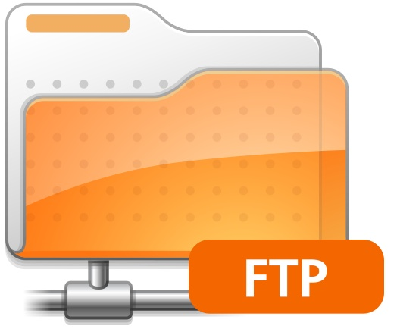
Evolution of Software Project Management Plan
Document Dissemination: fetched from centralized FTP on company intranet blarney.beliramparimal.com Employees to expect notice of updated docs adjoining weekly status reports | Project Manager gives weekly status reports | Monthly stakeholder meetings Accommodate international offices via video conferencing

Slide 6
Reference Material and Sites
Internal Project website – blarney.beliramparimal.com
SPMP – Software Project Management Plan Blarney Project
SCMP –Software Configuration Management Plan
SDP - Software Development Plan
SQAP- Software quality assurance plan
Existing BP software Documentation - SPMP
Domestic and International Tax and Salary Laws, eg. FICA
ISO 9000-1

Slide 7
Acronym Reference
BP – Beliram Parimal
IBM DBDC – IBM data dictionary compatibility
GL- General ledger; a complete record of financial transactions over the life of a company.
AP – Accounts Payable
SDE – Software development environment
FTP – File Transfer Protocol
PM – project manager
OT- overtime
UX- user experience
SPMP – Software Project Management Plan
CCB – Control Change Board

Slide 8
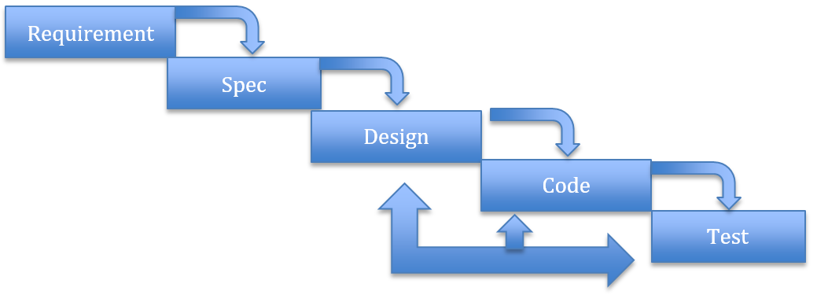
Software Development Life Cycle “Waterfall” Model

Slide 9
 | Requirement | Design | Code | Test
Entry | Budget Time and other resources Feature list | Business requirement done Framework | Prioritized Feature list IBM DBDC SDE decided Test server readied | Test plan approved Review/approval of code Develop test cases Test server
Exit | - Requirement written and approved by stakeholders | Prioritized feature list Approved design | Code done Unit and integration test Log known defects | Test data created Test plan executed Threshold of allowable defects satisfied

Slide 10
Project Organizational Structure in Context
Significant Improvement upon BP’s existing payroll system
Interfaces with existing external software such as General Ledger
Significant Improvement for existing customers
Contains attractions aimed at new customers
Aimed at increasing BP’s market share

Slide 11
Roles and Responsibilities
Project Manager
coordinating, planning, monitoring and documenting execution of plan
Technical Manager
Works under PM to coordinate design and development teams. Prioritizes design specifications.
Lead Developer
Coordinates software engineering teams and cycles
Test Lead
Coordinates testing cycles
Product Sponsor
Versed in Business Accounting needs, consults on requirements and specifications
Legal/Security and Business Accounting Consultants
Ensures compliance with domestic and international tax law and security protocols.
Marketing Liaison
Customer/Production Support
Takes care to anticipate customer needs in transition to new product.

Slide 12
Managerial Process – What?
Management objectives
Develop Blarney as a significant move in the Accounting Software Market
Apply BP’s financial and workforce resources efficiently while leveraging opportunity.
Constraints
cost: 50% of operating budget. This is a large move for BP.
time: Timeline constrained by high market anticipation. Need to move quickly.
Assumptions, Dependencies
Must comply by tax codes and laws, domestic and international.
Must maintain compatability with existing software such as General Ledger and IBM DBDC, as well as BP’s previous products.
Risk Management Plan
focus on risk avoidance by looking at lessons learned

Slide 13
Managerial Process – How?
Monitoring and controlling methods
Weekly Progress Meetings for Lead Staff and consultants
Weekly Status Reports – generated from above meeting
Project Manager to provide weekly status reports to stakeholders based on PM’s communications with other leads
Team Meetings
Each team lead will meet and discuss the progress and modifications necessary in the project with his or her team members. Lead will communicate back to PM during progress meetings.
Staffing
internal personnel, along with tax, legal, and business accounting consultants

Slide 14
CURRENT EDIT PROGRESS MARKER

Slide 15
Technical Process
Methods tools techniques
Operate on IBM DBDC, client-server environment, with PC at the front-end
Enterprise standards
ISO 9000-1
Software Documentation
normal enterprise documentation process
Software Requirement Specification
refer to Tech Lead
Software Design Description
refer to Lead Developer

Slide 16
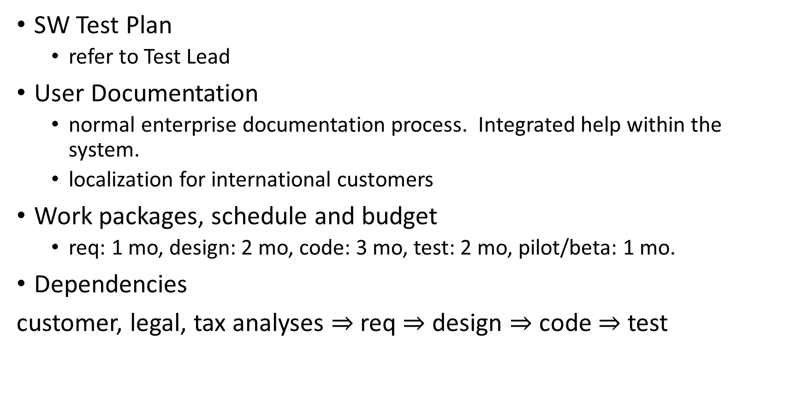
Technical Process Continued
SW Test Plan
refer to Test Lead
User Documentation
normal enterprise documentation process. Integrated help within the system.
localization for international customers
Work packages, schedule and budget
req: 1 mo, design: 2 mo, code: 3 mo, test: 2 mo, pilot/beta: 1 mo.
Dependencies
customer, legal, tax analyses $⇒$req $⇒$ design $⇒$ code $⇒$ test

Slide 17
Blarney

